Slide 1

Data Communication and Computer Network BLM3051
Dr. Öğr. Üyesi Furkan ÇAKMAK

Slide 2

Lecture Information
BLM3051
Data Communication and Computer Network - 1
Course Hours: Tuesday 09:00 – 11:50
All courses will be face 2 face.
For announcements: https://avesis.yildiz.edu.tr/fcakmak/dokumanlar
OBS Course/Bulk Messaging System
Google Classroom Class Code: b5ggwqk
You can ask your questions via Google Classroom
Zoom Personal Room:
https://us04web.zoom.us/j/3752287039?pwd=TTFKNittZWJTUEhHREovckl0VTVYUT09
Meeting ID: 375 228 7039
Passcode: 5AXMNd
For your questions and consultations about the course, make an appointment AT LEAST 1 (ONE) DAY BEFORE via the link below.
https://fcakmak.simplybook.it/v2/
No appointment will be made by e-mail.
Please be at the above mentioned Zoom room at the appointment time.
Dr. Öğr. Üyesi Furkan ÇAKMAK

Slide 3
Lecture Information - 2
BLM3051
Data Communication and Computer Network - 1
Students should ask the questions during the lesson out loud, NOT by writing.
The student who wants to ask questions must make himself/herself visible.
Students should keep their microphones OFF while listening, except when they ask.
In cases of possible long-term (> 1min) disconnection, the announcement regarding the continuation of the course will be made immediately on the Google Classroom page.
Students may record the lecture externally.
Lecture presentations will NOT be shared.
Dr. Öğr. Üyesi Furkan ÇAKMAK

Slide 4
Lecture Information Form - Weekly Subjects
BLM3051
Data Communication and Computer Network - 1
Hafta | Tarih | Konular
1 | 20.02.2024 | Introduction to Data Communication Standards Used on Data Communication, Architectural models
2 | 27.02.2024 | OSI Reference Model , Layers and Their Functions, Signaling and Signal Encoding
3 | 05.03.2024 | Parallel and Serial Transmission, Communication Media and Their Technical Specs., Multiplexing (TDM, FDM)
4 | 12.03.2024 | Error Detection and Error Correction Techniques, Data Link Control Techniques, Flow Control
5 | 19.03.2024 | Asynchronous and Synchronous Data Link Protocols (BSC, HDLC)
6 | 26.03.2024 | LAN Technologies Continued, IEEE 802.4, 802.5, 802.11
7 | 02.04.2024 | Connectionless and Connection Oriented Services, Switching
8 | 09.04.2024 | Tatil – Ramazan Bayramı Arifesi
9 | 16.04.2024 | 1. Ara Sınav
10 | 23.04.2024 | Tatil – 23 Nisan Ulusal Egemenlik ve Çocuk Bayramı
11 | 30.04.2024 | Static and Dynamic Routing, Congestion in the Network Layer, Its Causes and Solutions
12 | 07.05.2024 | IP (Internetworking Protocol), ICMP, BOOTP, DHCP
13 | 14.05.2024 | 2. Ara Sınav
14 | 21.05.2024 | UDP (User Datagram Protocol), TCP (Transmisson Control Protocol)
Dr. Öğr. Üyesi Furkan ÇAKMAK

Slide 5
Lecture Information Form– Coursebook
BLM3051
Data Communication and Computer Network - 1
 | Coursebooks
1 | Introduction to Data Communications & Networking, Behrouz Foruzan
2 | Computer Networks 2e, Andrew S. Tanenbaum
3 | Data Networks:Concepts, Theory and Practice, Uyless D.Black
4 | Routing & Switching: Time of convergence, Puzmanova
Dr. Öğr. Üyesi Furkan ÇAKMAK

Slide 6
Lecture Information Form– Evaluation
BLM3051
Data Communication and Computer Network - 1
Evaluation System | Method | # | Impact (%)
 | Midterms | 2 | 40
 | Quizs | - | -
 | Homeworks | - | -
 | Projects | 1 | 20
 | Semester Project | - | -
 | Laboratory | - | -
 | Other | - | -
 | Final Exam | 1 | 40
Dr. Öğr. Üyesi Furkan ÇAKMAK

Slide 7
What is Communication?
BLM3051
Data Communication and Computer Network - 1
Sharing information/data
Telecommunication (Tele -> far *Greek)
Communication Aim: Trafic data
Telephone, Television, vb.
Ses, video, resim
Computer
Medium/Media -> 0/1
Protocol Stack: Software and Hardware
Dr. Öğr. Üyesi Furkan ÇAKMAK

Slide 8
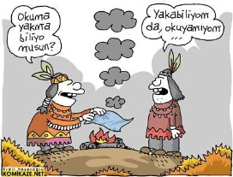
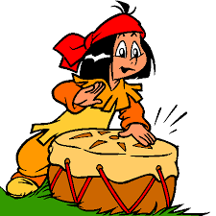


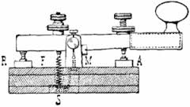

What is Communication? – Con’t
BLM3051
Data Communication and Computer Network - 1
Humanity History: 200k
Sumerians: B.C 4000
«Verba volant, scripta manent»
Copper Cable
Telegraph: 1837-1838
Telephone: 1876
Dr. Öğr. Üyesi Furkan ÇAKMAK
Notes:
Söz uçar, yazı kalır.
Bakır Kable

Slide 9
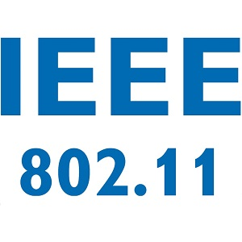
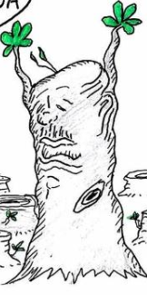
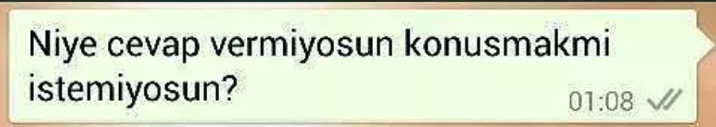
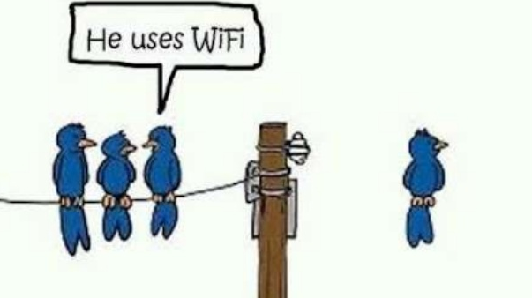
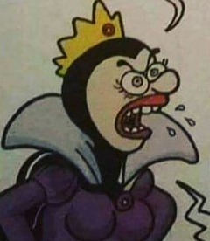
Essentials of Data Communication
BLM3051
Data Communication and Computer Network - 1
Message
Sender
Receiver
Medium
Protocol
Dr. Öğr. Üyesi Furkan ÇAKMAK

Slide 10
Data Communication
BLM3051
Data Communication and Computer Network - 1
Protocol
Message
Medium
Sender
Receiver
Dr. Öğr. Üyesi Furkan ÇAKMAK

Slide 11

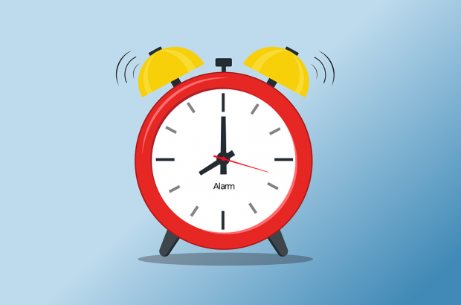

Data Comm. Features
BLM3051
Data Communication and Computer Network - 1
Delivery
Accuracy
Timeliness
Dr. Öğr. Üyesi Furkan ÇAKMAK

Slide 12


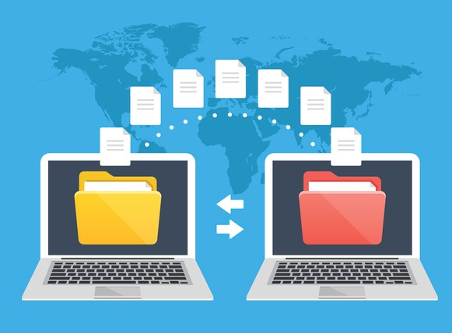
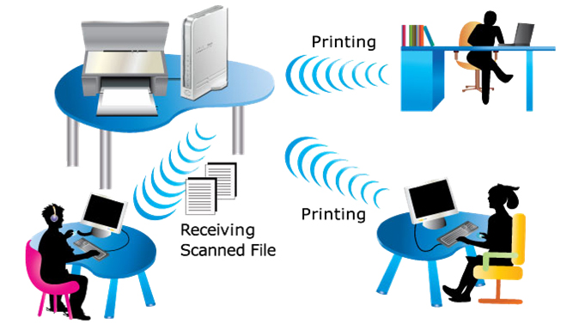
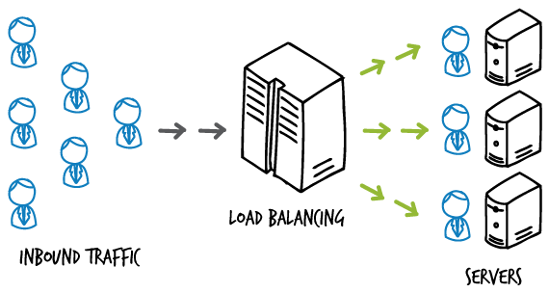
Pros of Computer Network
BLM3051
Data Communication and Computer Network - 1
Resource Sharing
Info/Data Sharing
Load Sharing / Balancing
Reliability
Econmony
Efficient communication between in different places
Dr. Öğr. Üyesi Furkan ÇAKMAK

Slide 13
Evaluation Criteria for Computer Networks
BLM3051
Data Communication and Computer Network - 1
Performance
Transmit time
Response time
QoS
Circuit-switched (Synchronous)→ Bit rate, Min Error Rate, Transmission Rate
Packet-switched (Asynchronous) → Maximum Packet Size, Mean Packet Transfer Rate, Mean Packet Error Rate, Jitter, Mean Packet Transmit Delay
Reliability/Availability
MTBF – Mean Time Between Failure
Restoring Time
5-9 → 99,999%
Security
Scaleable
Adaptable
Software, Hardware
Dr. Öğr. Üyesi Furkan ÇAKMAK
Notes:
MTBF – Mean Time Between Failure -> Hata Oluşma Sıklığı

Slide 14
Network Standards
BLM3051
Data Communication and Computer Network - 1
De Jure
ISO (International Organization for Standardization)
ITU (The International Telegraph and Telephone Consultative Committee)
IEEE (The Institute of Electrical and Electronics Engineers)
ETSI (The European Telecommunications Standards Institute)
EIA (Energy Information Administration)
TIA (Telecommunications Industry Association)
ANSI (American National Standards Institute)
TSE (Türk Standartları Enstitüsü)
IETF (Internet Engineering Task Force)
De Facto
QWERTY keyboards
VHS video format
PDF document type
Buttons on men's shirts are on the right, buttons on women's shirts are on the left.
Dr. Öğr. Üyesi Furkan ÇAKMAK
Notes:
MTBF – Mean Time Between Failure -> Hata Oluşma Sıklığı

Slide 15
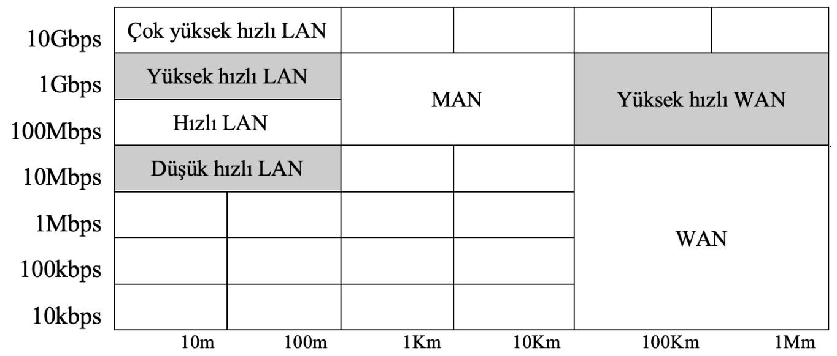
Computer Network (CN)
BLM3051
Data Communication and Computer Network - 1
ARPANET (1970s)
Classification of CN
Technique of Tranmission
Broadcast
Peer to peer – P2P
Network Dimension
PAN-Personal Area Network (< 10m)
LAN-Local Area Network (< 100m-200m)
CAN-Campus Area Network (< 1-5km)
MAN-Metropolitan Area Network (< 10-50km)
RAN-Regional Area Network (< 100-200km)
WAN- Wide Area Network (< 1000km)
Bit Rate
Dr. Öğr. Üyesi Furkan ÇAKMAK
Notes:
MTBF – Mean Time Between Failure -> Hata Oluşma Sıklığı

Slide 16
Topology
BLM3051
Data Communication and Computer Network - 1
Bus
Star
Tree
Ring
Mesh
Hybrid
Dr. Öğr. Üyesi Furkan ÇAKMAK
Notes:
MTBF – Mean Time Between Failure -> Hata Oluşma Sıklığı

Slide 17
Bus Topology
BLM3051
Data Communication and Computer Network - 1
Dr. Öğr. Üyesi Furkan ÇAKMAK
Notes:
MTBF – Mean Time Between Failure -> Hata Oluşma Sıklığı

Slide 18
Star Topology
BLM3051
Data Communication and Computer Network - 1
Dr. Öğr. Üyesi Furkan ÇAKMAK
Notes:
MTBF – Mean Time Between Failure -> Hata Oluşma Sıklığı

Slide 19
Tree Topology
BLM3051
Data Communication and Computer Network - 1
Dr. Öğr. Üyesi Furkan ÇAKMAK
Notes:
MTBF – Mean Time Between Failure -> Hata Oluşma Sıklığı

Slide 20
Ring Topology
BLM3051
Data Communication and Computer Network - 1
Dr. Öğr. Üyesi Furkan ÇAKMAK
Notes:
MTBF – Mean Time Between Failure -> Hata Oluşma Sıklığı

Slide 21
Mesh Topology
BLM3051
Data Communication and Computer Network - 1
Dr. Öğr. Üyesi Furkan ÇAKMAK
Notes:
MTBF – Mean Time Between Failure -> Hata Oluşma Sıklığı

Slide 22
Hybrid Topology
BLM3051
Data Communication and Computer Network - 1
Dr. Öğr. Üyesi Furkan ÇAKMAK
Notes:
MTBF – Mean Time Between Failure -> Hata Oluşma Sıklığı

Slide 23
Transmission Model
BLM3051
Data Communication and Computer Network - 1
Simplex
Mouse
Bar Code Reader
Half-Duplex
Radio
Duplex
LAN
Dr. Öğr. Üyesi Furkan ÇAKMAK
Notes:
MTBF – Mean Time Between Failure -> Hata Oluşma Sıklığı

Slide 24
Addressing Model
BLM3051
Data Communication and Computer Network - 1
Broadcast
TV
Multicast
Stream Video
Anycast
DNS
Unicast
Letter
Dr. Öğr. Üyesi Furkan ÇAKMAK
Notes:
MTBF – Mean Time Between Failure -> Hata Oluşma Sıklığı

Slide 25
Data Flow Density, Bit Rate, Throughput
BLM3051
Data Communication and Computer Network - 1
Symmetric
Asymmetric
bps (bit-ps), Bps (Byte-ps)
Kilo (k), Mega (M), Giga (G), Tera (T), Peta (P), Exa (E), Zetta (Z) ve Yotta (Y)
Throughput
Response time
Jitter
Dr. Öğr. Üyesi Furkan ÇAKMAK
Notes:
MTBF – Mean Time Between Failure -> Hata Oluşma Sıklığı

Slide 26
OSI Reference Model
BLM3051
Data Communication and Computer Network - 1
ISO – 1984
De Jure
Features
Open
Flexible
Robust
Interoperable
Easy to explain
Easy to understand
7-layers
Never applied / Ideal Model
7 | Application Layer
6 | Presentation Layer
5 | Session Layer
4 | Transport Layer
3 | Network Layer
2 | Data Link Layer
1 | Physical Layer
Dr. Öğr. Üyesi Furkan ÇAKMAK

Slide 27
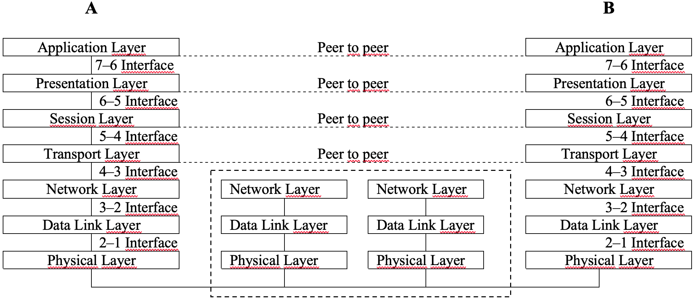
OSI Reference Model – Con’t
BLM3051
Data Communication and Computer Network - 1
User
Support
Layers
Service
Layer
Network
Support
Layers
Dr. Öğr. Üyesi Furkan ÇAKMAK

Slide 28

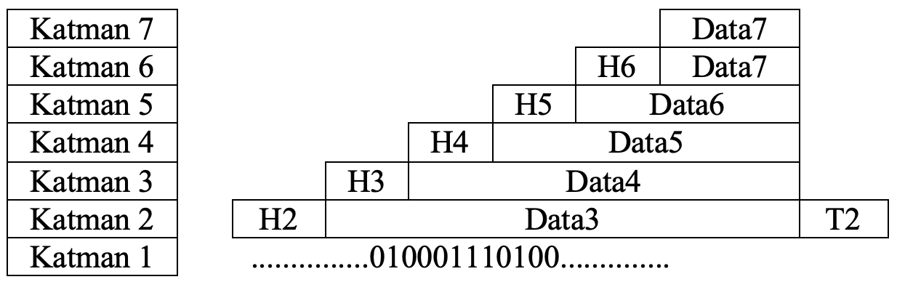
OSI Reference Model – Con’t
BLM3051
Data Communication and Computer Network - 1
Each layers add a header package.
Only second layer (Data link) add a trailer end of the package.
Error control
Encapsulation
Dr. Öğr. Üyesi Furkan ÇAKMAK

Slide 29
OSI – Physical Layer
BLM3051
Data Communication and Computer Network - 1
Responsible for trasmitting bit arrays between peers.
General functions of the Physical Layer;
Electromechanic
Direction of the package
Determining magnitudes of signals
Amplitude, Wavelength, Frequency
Initiation and termination of the physical connection.
7 | Application Layer
6 | Presentation Layer
5 | Session Layer
4 | Transport Layer
3 | Network Layer
2 | Data Link Layer
1 | Physical Layer
Dr. Öğr. Üyesi Furkan ÇAKMAK

Slide 30
OSI – Data Link Layer
BLM3051
Data Communication and Computer Network - 1
Extract/divide frames from the messages.
Send frames to receiver side in an order.
Using acknowledgment (ACK) info;
In case of an error,
In case of not receive the package,
Re-transmission
Add header and trailer data to frames.
To determine the starting and ending points of the frame.
Header includes;
Sender address,
Receiver address,
Order info
Trailer includes;
A code (to check errors)
7 | Application Layer
6 | Presentation Layer
5 | Session Layer
4 | Transport Layer
3 | Network Layer
2 | Data Link Layer
1 | Physical Layer
Dr. Öğr. Üyesi Furkan ÇAKMAK

Slide 31
OSI – Data Link Layer – Con’t
BLM3051
Data Communication and Computer Network - 1
General functions of the Data Link Layer;
Node to node error free delivery
Addressing (in header part)
MAC Address
Access Control
Flow Control
Error Handling
Synchronization
In Local Area Network (LAN)
DLL divides into 2 different layers;
LLC (Logical Link Control)
MAC (Media Access Control)
Communication at the data link layer is in the same network.
7 | Application Layer
6 | Presentation Layer
5 | Session Layer
4 | Transport Layer
3 | Network Layer
2 | Data Link Layer
1 | Physical Layer
Dr. Öğr. Üyesi Furkan ÇAKMAK

Slide 32
OSI – Network Layer
BLM3051
Data Communication and Computer Network - 1
Network layer is responsible for;
Efficiently and accurately forwarding the packet
From source to destination over different network links.
Communication at the network layer is in the different network
Router (3rd level devices)
Switching
Connection oriented
like telephone infrastructure system
Routing
Determining the path between sender and receiver
Connectionless
Delivering packages
In DLL, data transfer occurs between nodes
7 | Application Layer
6 | Presentation Layer
5 | Session Layer
4 | Transport Layer
3 | Network Layer
2 | Data Link Layer
1 | Physical Layer
Dr. Öğr. Üyesi Furkan ÇAKMAK

Slide 33
OSI – Network Layer – Con’t
BLM3051
Data Communication and Computer Network - 1
Address must be different from DLL’s addresses.
Logical Address
Data transfer occurs between the source and the destination.
General functions of the Network Layer;
Source to Destination packet delivery
Logical addressing
Routing
Address transformation
Between logical and physical addresses
Multiplexing
Multiple physical connections on a single newtwork connection at the same time
7 | Application Layer
6 | Presentation Layer
5 | Session Layer
4 | Transport Layer
3 | Network Layer
2 | Data Link Layer
1 | Physical Layer
Dr. Öğr. Üyesi Furkan ÇAKMAK

Slide 34
OSI – Transport Layer
BLM3051
Data Communication and Computer Network - 1
Responsible for the transmission of data
from source to destination
Network layer responsible for delivering data
Transport layer responsible for delivering packages
data = package[]
Data transmission is between applications, not computers.
An additional addressing mechanism is required
to distinguish the applications from each other.
Service Access Point – SAP
Ports, Sockets
Transport layer divides the incoming information into pieces (segment) in sizes supported by the infrastructure.
Segmentation
Sequence number
Re-assembly
7 | Application Layer
6 | Presentation Layer
5 | Session Layer
4 | Transport Layer
3 | Network Layer
2 | Data Link Layer
1 | Physical Layer
Dr. Öğr. Üyesi Furkan ÇAKMAK

Slide 35
OSI – Transport Layer – Con’t
BLM3051
Data Communication and Computer Network - 1
There are two types of services.
Connectionless
Like post services
Connection oriented
Like phone services
Establish connection
Data transmission
Terminate connection
More control over the data to be transferred
General functions of the Transport Layer;
Data transmission between source and destionation nodes
To provide data flow between applications with the help of service points
Segmentation & Re-assembling
Ensuring connection control
Connectionless | Connection oriented
7 | Application Layer
6 | Presentation Layer
5 | Session Layer
4 | Transport Layer
3 | Network Layer
2 | Data Link Layer
1 | Physical Layer
Dr. Öğr. Üyesi Furkan ÇAKMAK

Slide 36
OSI – Session Layer
BLM3051
Data Communication and Computer Network - 1
This layer is responsible for ensuring continuity.
Synchronization
Choosing connection type
Half-duplex
Duplex
Session data transfering
Password
Logon verification
Sessions can be split into sub-sessions to ensure the reliability of the connection
Sub-sessions are provided with checkpoint information.
7 | Application Layer
6 | Presentation Layer
5 | Session Layer
4 | Transport Layer
3 | Network Layer
2 | Data Link Layer
1 | Physical Layer
Dr. Öğr. Üyesi Furkan ÇAKMAK
Notes:
MTBF – Mean Time Between Failure -> Hata Oluşma Sıklığı

Slide 37
OSI – Session Layer – Con’t
BLM3051
Data Communication and Computer Network - 1
General functions of the Session Layer;
Managing the session
Communication control
if it is half-duplex
Ensuring synchronization
Gracefull close
7 | Application Layer
6 | Presentation Layer
5 | Session Layer
4 | Transport Layer
3 | Network Layer
2 | Data Link Layer
1 | Physical Layer
Dr. Öğr. Üyesi Furkan ÇAKMAK

Slide 38
OSI – Presentation Layer
BLM3051
Data Communication and Computer Network - 1
General functions of the Presentation Layer;
Provides interoperability by eliminating possible differences in information representation between devices during data communication
Abstract data syntax
Encryption & Decryption
Compression & Decompression
7 | Application Layer
6 | Presentation Layer
5 | Session Layer
4 | Transport Layer
3 | Network Layer
2 | Data Link Layer
1 | Physical Layer
Dr. Öğr. Üyesi Furkan ÇAKMAK

Slide 39
OSI – Application Layer
BLM3051
Data Communication and Computer Network - 1
User Interfaces
Electronical mail (e-mail)
File transfering
Remote desktop control
Internet explorer
vb.
7 | Application Layer
6 | Presentation Layer
5 | Session Layer
4 | Transport Layer
3 | Network Layer
2 | Data Link Layer
1 | Physical Layer
Dr. Öğr. Üyesi Furkan ÇAKMAK

Slide 40
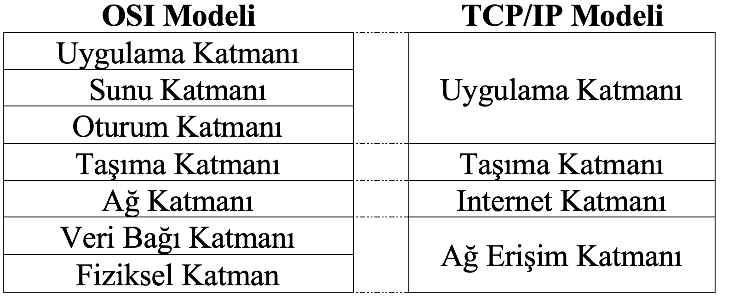
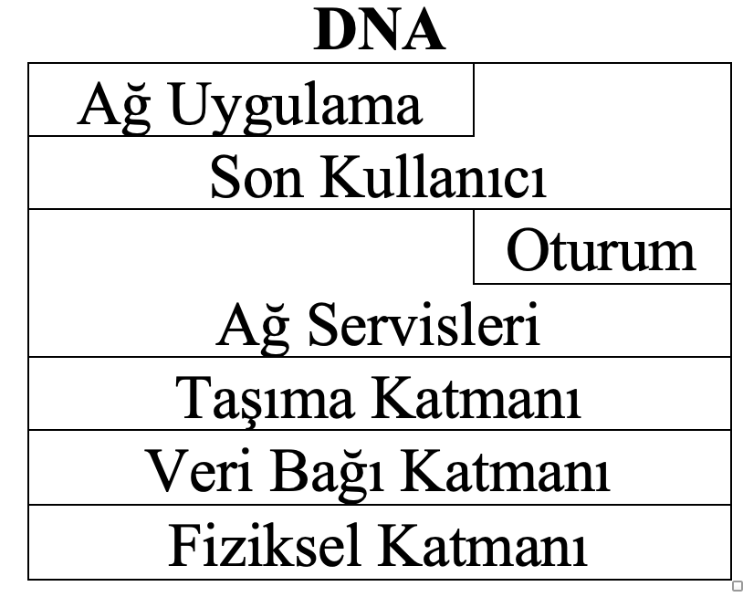
Other Network Models
BLM3051
Data Communication and Computer Network - 1
Dr. Öğr. Üyesi Furkan ÇAKMAK

Slide 41
Thank you for your listening.
BLM3051
Data Communication and Computer Network - 1
Dr. Öğr. Üyesi Furkan ÇAKMAK

